Slide 1
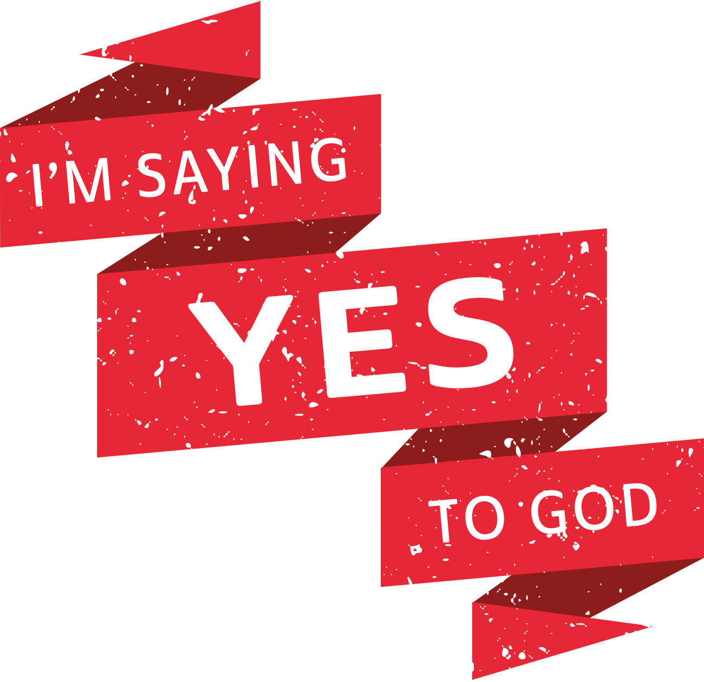
COVENANT RENEWAL SUNDAY

Slide 2
IT’S ANANI-YES, NOT ANANI-NO > Jesus was crucified shortly before this in AD 29 and had risen from the dead three days later. > The Book of Acts opens after Christ’s rising. Jesus commissions the disciples to preach the gospel in Acts 1. > Opposition to new Christ followers - Saul set on bringing them down.

Slide 3
ACTS 9:1-19 Saul’s Conversion ⁹ Meanwhile, Saul was still breathing out murderous threats against the Lord’s disciples. He went to the high priest ² and asked him for letters to the synagogues in Damascus, so that if he found any there who belonged to the Way, whether men or women, he might take them as prisoners to Jerusalem. ³ As he neared Damascus on his journey, suddenly a light from heaven flashed around him. ⁴ He fell to the ground and heard a voice say to him, “Saul, Saul, why do you persecute me?” ⁵ “Who are you, Lord?” Saul asked. “I am Jesus, whom you are persecuting,” he replied. ⁶ “Now get up and go into the city, and you will be told what you must do.”

Slide 4
⁷ The men traveling with Saul stood there speechless; they heard the sound but did not see anyone. ⁸ Saul got up from the ground, but when he opened his eyes he could see nothing. So they led him by the hand into Damascus. ⁹ For three days he was blind, and did not eat or drink anything. ¹⁰ In Damascus there was a disciple named Ananias. The Lord called to him in a vision, “Ananias!” “Yes, Lord,” he answered. ¹¹ The Lord told him, “Go to the house of Judas on Straight Street and ask for a man from Tarsus named Saul, for he is praying. ¹² In a vision he has seen a man named Ananias come and place his hands on him to restore his sight.” ¹³ “Lord,” Ananias answered, “I have heard many reports about this man and all the harm he has done to your holy people in Jerusalem. ¹⁴ And he has come here with authority from the chief priests to arrest all who call on your name.”

Slide 5
¹⁵ But the Lord said to Ananias, “Go! This man is my chosen instrument to proclaim my name to the Gentiles and their kings and to the people of Israel. ¹⁶ I will show him how much he must suffer for my name.” ¹⁷ Then Ananias went to the house and entered it. Placing his hands on Saul, he said, “Brother Saul, the Lord—Jesus, who appeared to you on the road as you were coming here—has sent me so that you may see again and be filled with the Holy Spirit.” ¹⁸ Immediately, something like scales fell from Saul’s eyes, and he could see again. He got up and was baptized, ¹⁹ and after taking some food, he regained his strength.

Slide 6
SAYING YES TO GOD MEANS WE… 1. LISTEN > God speaks to both Paul and Ananias > Ananias knew the voice and answered, ‘Yes, Lord’ > God speaks to us in different ways > Saul needed the dramatic, Ananias saw a vision How might God be trying to get your attention? Are you listening for the prompts and calls of God? What might he be asking you to saying yes to?

Slide 7
SAYING YES TO GOD MEANS WE… 2. TRUST > We’re created with free will – Ananias questions God > We should affirm God’s calling > Then we need to trust God’s plan is the best plan > God’s commands don’t always make sense, but they’re always right What passions and dreams has God placed on your heart? Do you trust him in these?

Slide 8
SAYING YES TO GOD MEANS WE… 3. ACT > Easy to say yes until we have to follow through > Saying yes to God means we walk the talk – ‘GO’ > Our small ‘yes’s’ to God can having a lasting, wide-reaching impact > Being a Christ follower involves putting our faith into action What is holding you back from living out God’s calling? In what area of your life do you need courage to act? What do you need to leave behind to move into God’s calling?

Slide 9
SAYING YES TO GOD MEANS WE… 4. BELIEVE > Ananias had enough faith in God to go to Saul’s house – called him ‘brother’ > “Most of us believe God can move mountains, but how many of us believe he will?” > Ananias only mentioned two times but the legacy of his obedience still impacts us today > We might never know the impact of our ‘yes’ How big is your faith? Do you struggle to believe God will truly make a difference? What do you need faith for in your life that God can do the impossible?

Slide 10
LISTEN: We need to be listening to God’s calling TRUST: We need to trust God’s plan ACT: We need to put our faith into action BELIEVE: We need to believe God can do the impossible

Slide 11
WHAT WOULD IT LOOK LIKE FOR YOU TO SAY YES TO GOD?

